Slide 1

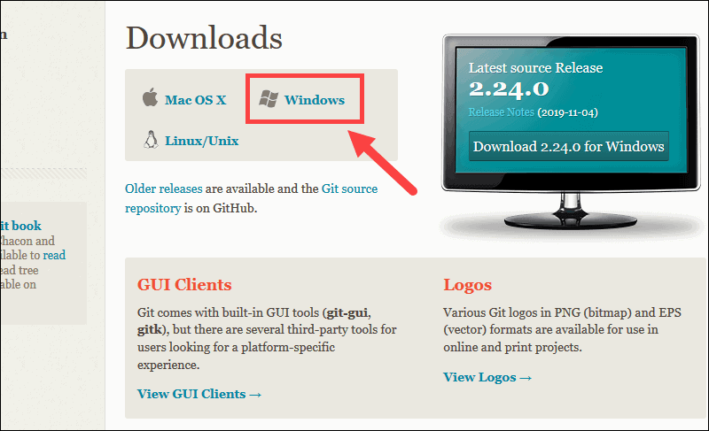
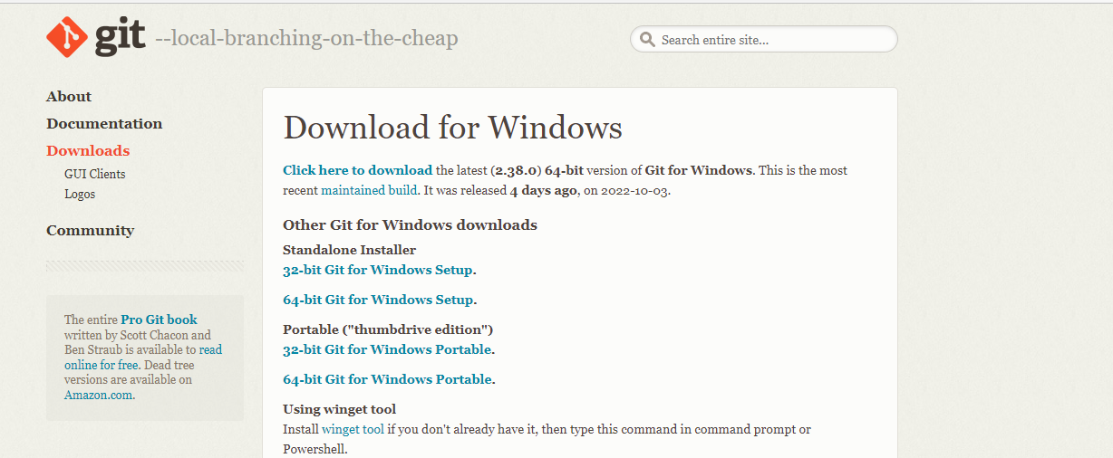

How to Install Git (for hands on demo)
https://git-scm.com/downloads
Download "Git Bash" for Windows
$ brew install git on Mac
$ sudo apt-get install git or $ yum install git for Linux
Verify Installation:
$ git --version
Install with all the default settings.
Notes:
Print and have on people’s seat. 70 copies
Add instruction: When wizard is open, use all defaults.

Slide 2

Introduction
Notes:
Setup:
Marketing material
Introduce dKomplex
Goal: create an attraction. Bring awareness about company.
-We are a net exporter of talent
-We have hired and trained CSUMB students
-We’re looking for a few good people. The best of the best.
-Move young talented people up. You get the opportunity to be in a big role.
-You get real responsibility and experience with us.
-I’m looking to hire throughout the year and keep our pipeline full of talented developers and analysts.
-Right now
-Which one of you is the next dkomplexer?
-
Remarks
-
Call Ben up to introduce
-

Slide 3
Version Control Presentation
Presented By:
Ben Wilson, Azure DevOps Engineer / Admin
dKomplex IT

Slide 4
Outcomes
Demonstrate the importance of using Git
Understand foundational
Git concepts
3. Be able to make commits
(hands on portion)

Slide 5
1. The Importance of Git
Notes:
Setup:
Marketing material
Introduce dKomplex
Goal: create an attraction. Bring awareness about company.
-We are a net exporter of talent
-We have hired and trained CSUMB students
-We’re looking for a few good people. The best of the best.
-Move young talented people up. You get the opportunity to be in a big role.
-You get real responsibility and experience with us.
-I’m looking to hire throughout the year and keep our pipeline full of talented developers and analysts.
-Right now
-Which one of you is the next dkomplexer?
-
Remarks
-
Call Ben up to introduce
-

Slide 6

Group Discussion
Five minutes
Describe what you think Git is
Describe what you can do with Git
Why does version control matter?

Slide 7
Group Discussion
Five minutes
What is your reaction to this information?
What did you learn?

Slide 8
Why Does Version Control Matter?
Collaboration
Creating History
Looking Professional

Slide 9
Who Uses Git?
What percentage of professional developers use Git?
How do most professional developers interact with Git?

Slide 10
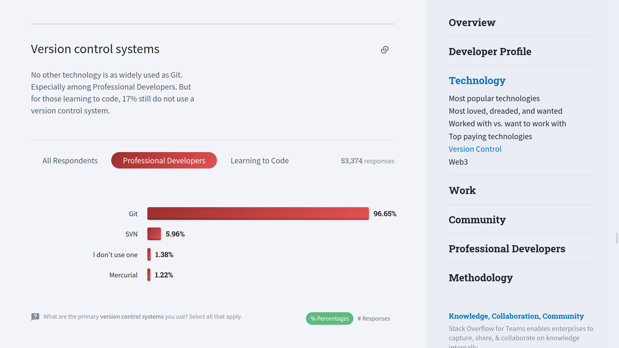

Slide 11
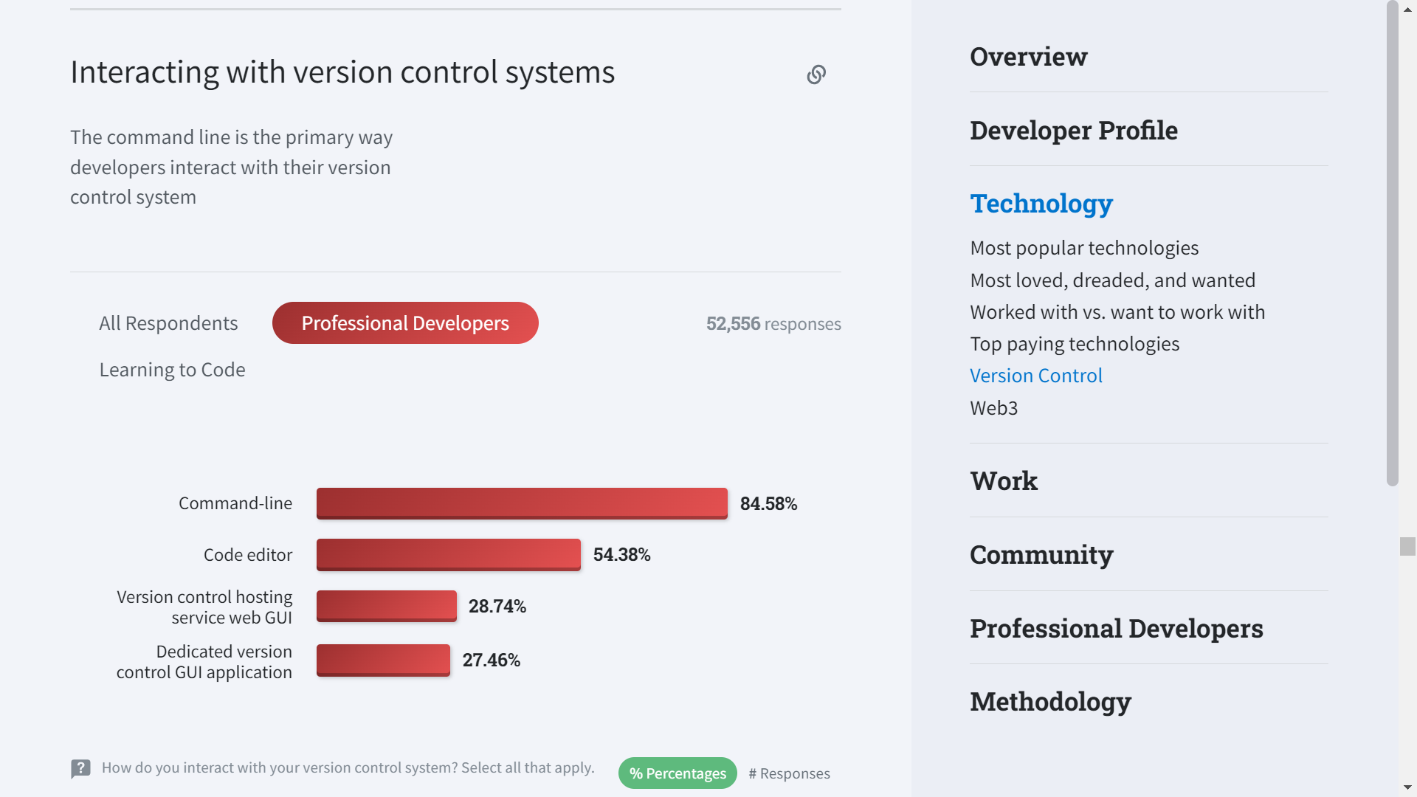

Slide 12
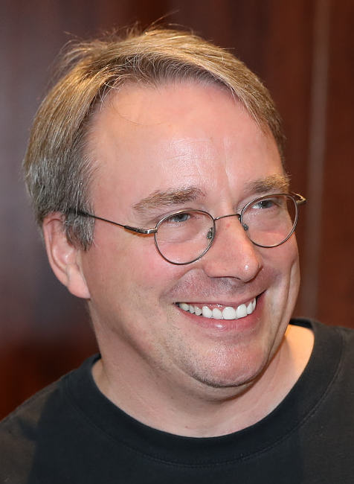
Git History
Authored by Linus Torvalds in 2005 to help with development of the Linux Kernel
Linus Torvalds joked about the naming his tool 'git' which means "unpleasant person" in British slang.
"I'm an egotistical bastard, and I name all my projects after myself. First 'Linux', now 'git'."
Previous Version Control tools included Source Code Control System (SCCS) in 1972, CVS in 1986, and Apache Subversion (SVN) in 2000.
Torvalds created a huge advantage over older tools with his distributed version control model as well as Git's "killer feature"

Slide 13
2. Git Concepts
Notes:
Setup:
Marketing material
Introduce dKomplex
Goal: create an attraction. Bring awareness about company.
-We are a net exporter of talent
-We have hired and trained CSUMB students
-We’re looking for a few good people. The best of the best.
-Move young talented people up. You get the opportunity to be in a big role.
-You get real responsibility and experience with us.
-I’m looking to hire throughout the year and keep our pipeline full of talented developers and analysts.
-Right now
-Which one of you is the next dkomplexer?
-
Remarks
-
Call Ben up to introduce
-

Slide 14
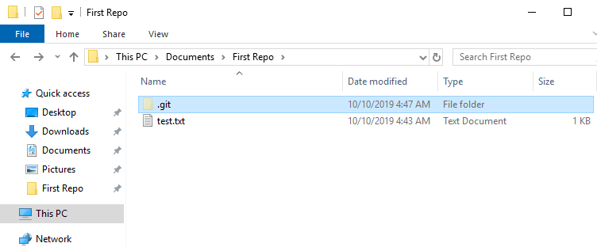
What is a Repository?
A repository is a folder which contains your code.
All Git repositories contain a hidden .git folder where Git stores its data.
If you delete the .git folder it is no longer a Git repository, it is just a folder with code in it.

Slide 15
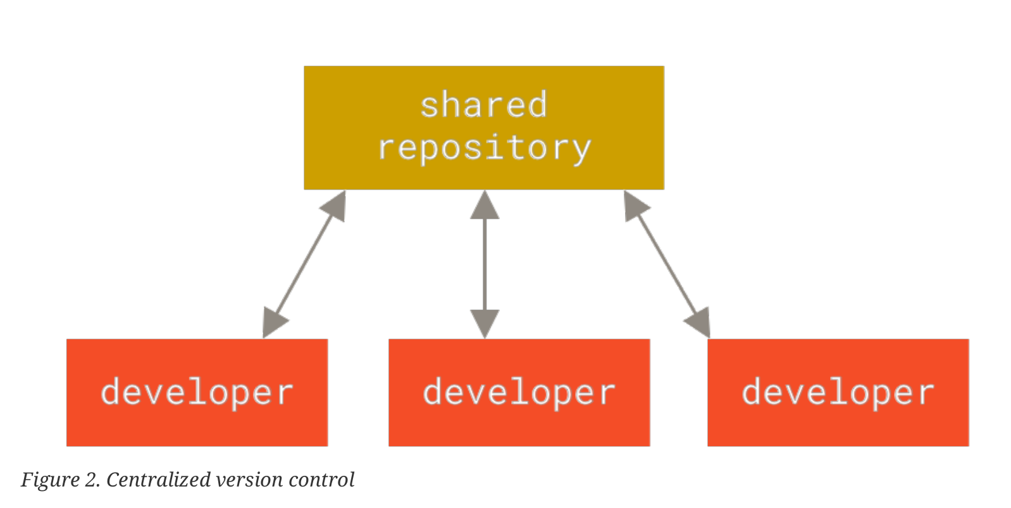
Centralized Version Control (outdated)
A single server contains all the versioned files
Clients can check out code from the central repository individually
Becomes problematic if the server goes down or if people work on the same code
Danger of losing all code
Includes CVS and SVN
Has been the industry standard for many years
1. Chacon, Pro Git, 11.

Slide 16

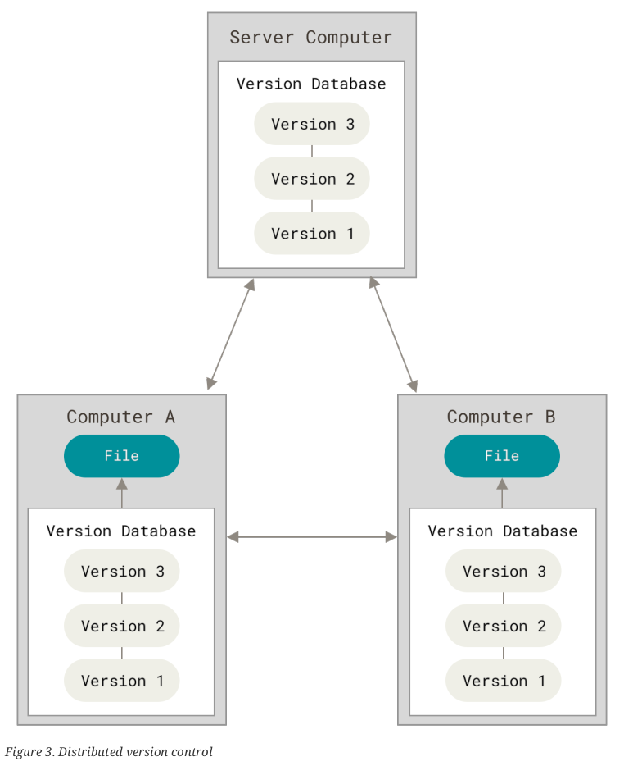


Distributed Version Control (current)
Each computer fully mirrors the central repository hosted by the server
Each clone of the repository contains the project's full history
Every clone is a full backup of the data
Developers can collaborate with various groups simultaneously in the same project
1. Chacon, Pro Git, 12.

Slide 17
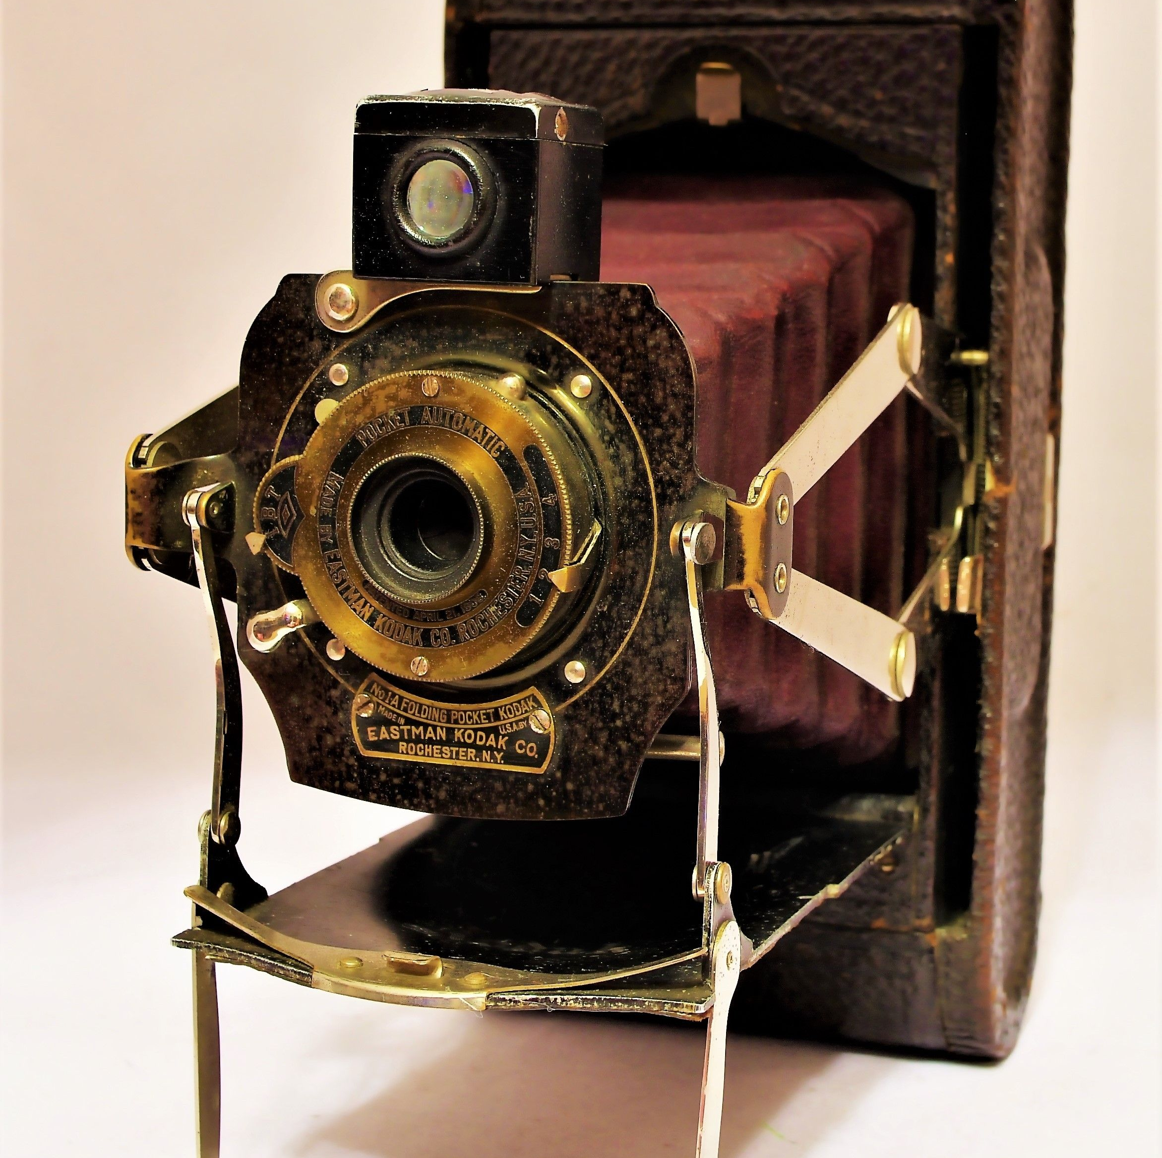
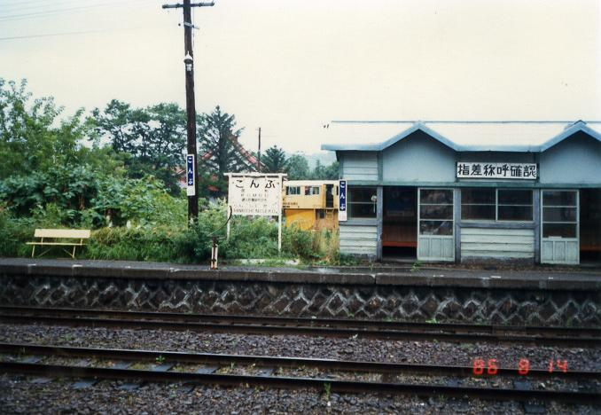
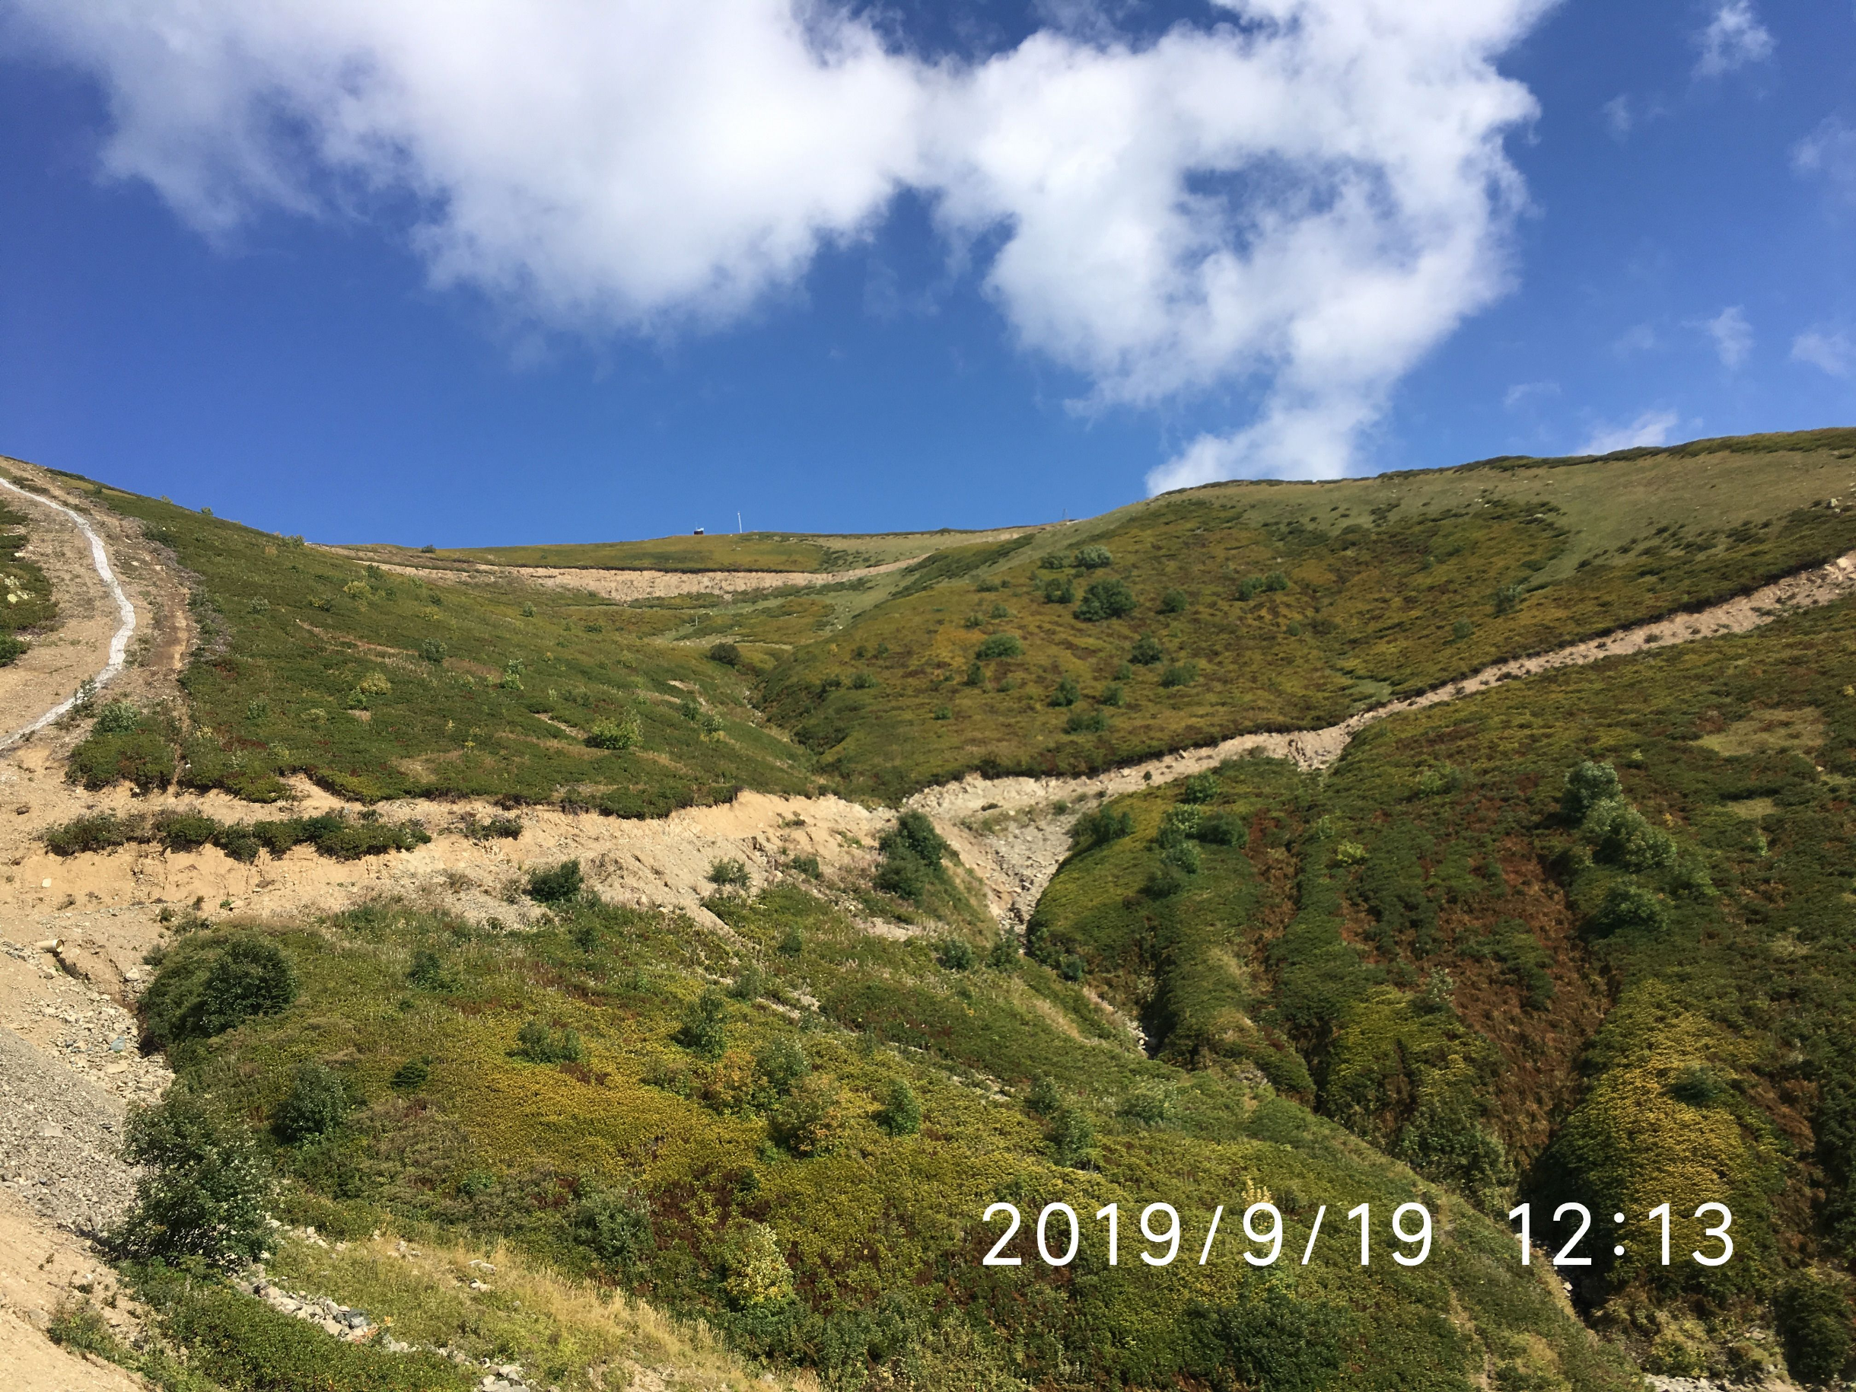
Git as a Camera
How Git sees data
Git stores snapshots of files in your repository
Each snapshot becomes a record of what the files in the repository looked like at one point in time
A Git commit can be thought of as a photograph

Slide 18
Git as a Camera
How Git sees data
The major difference between Git and other version control tools is how it views changes.
Git sees a series of snapshots of a filesystem.
Git commits can be thought of as a photographic record of the history of the files going back in time.

Slide 19

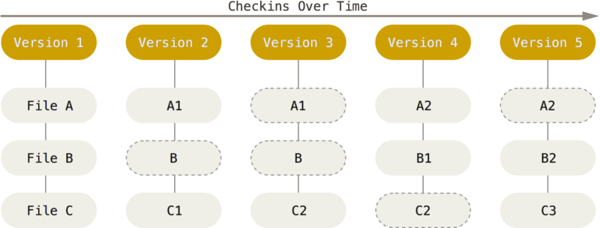
Git as a Camera
How Git sees data
Git stores commits as changes to a base version.
If a file is not changed, git does not store it.
Only storing changes uses less data
1. Chacon, Pro Git, 14.

Slide 20

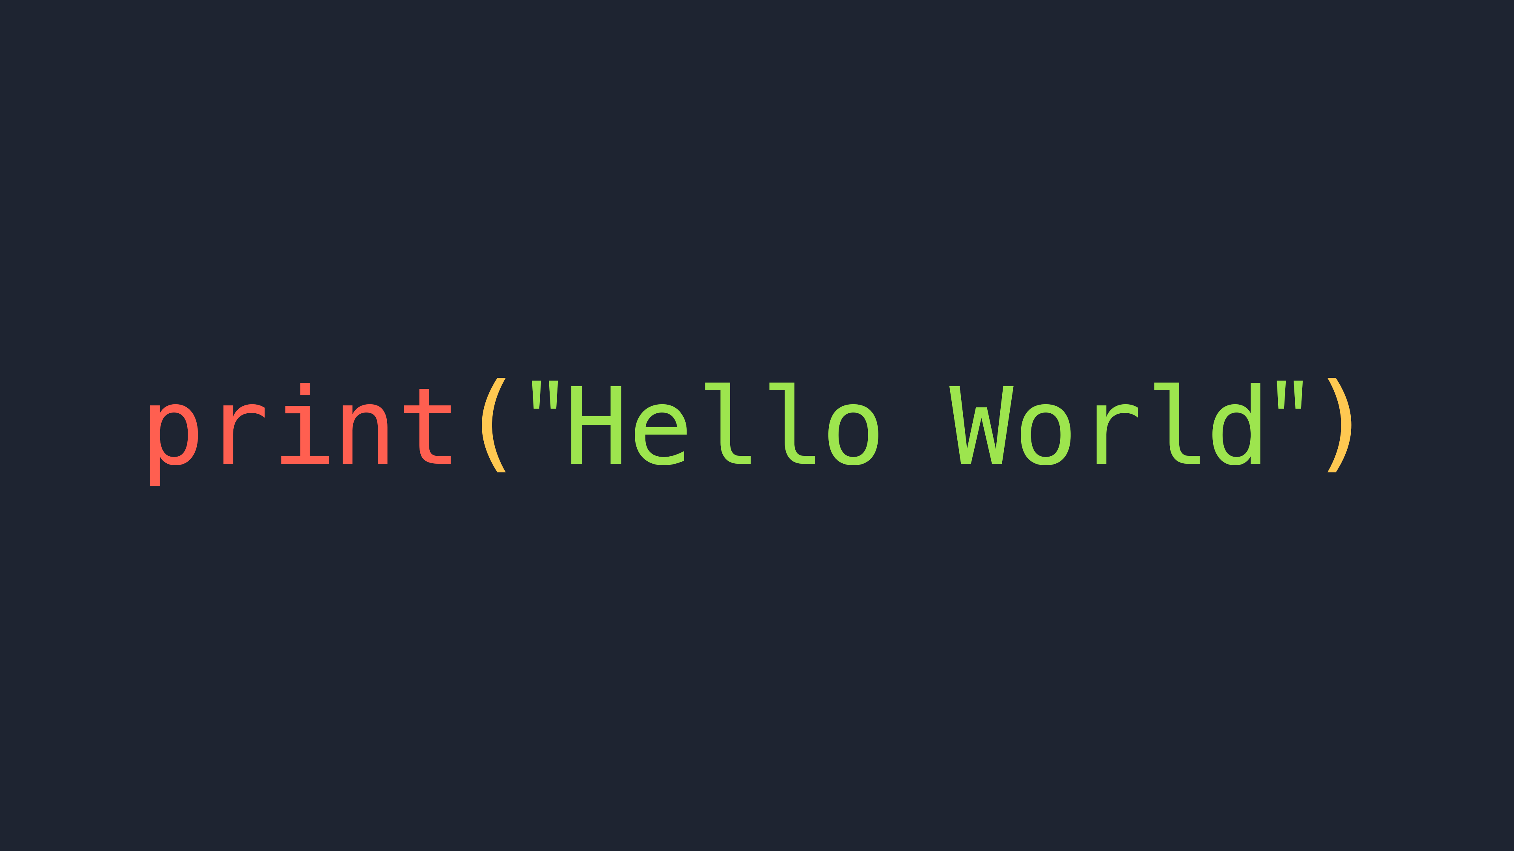

How Git views changes
Git does not record anything if no changes have been made to a file
A commit cannot to be made to a file if the file has not changed

Slide 21
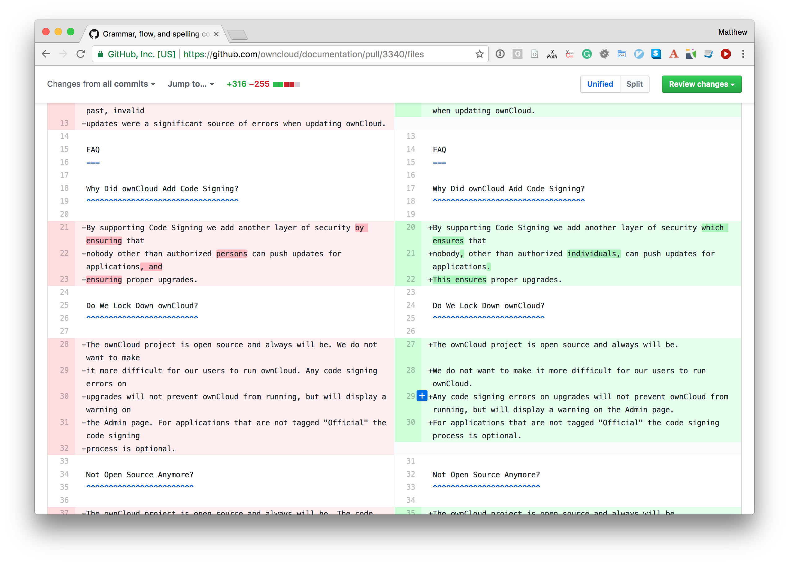
How Git views changes
Git will only see the specific changes that were made to a file since the previous version
A Git commit is a snapshot of what has been added and what has been removed from a file
Changes are compared to the previous commit

Slide 22
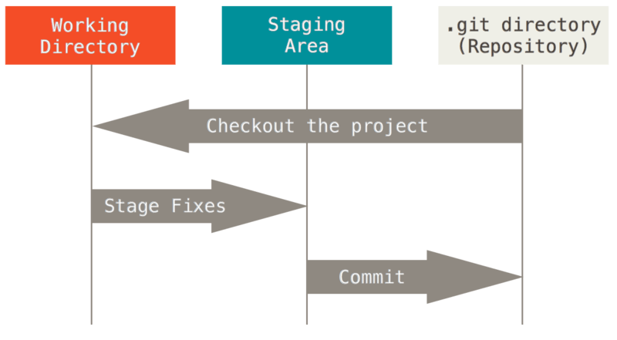


Three Stages of a Commit
Modified means that you have changed the file but have not committed it yet.
Staged means that you have marked a modified file in its current version to go into your next commit snapshot.
Committed means that the snapshot is stored in Git.

Slide 23
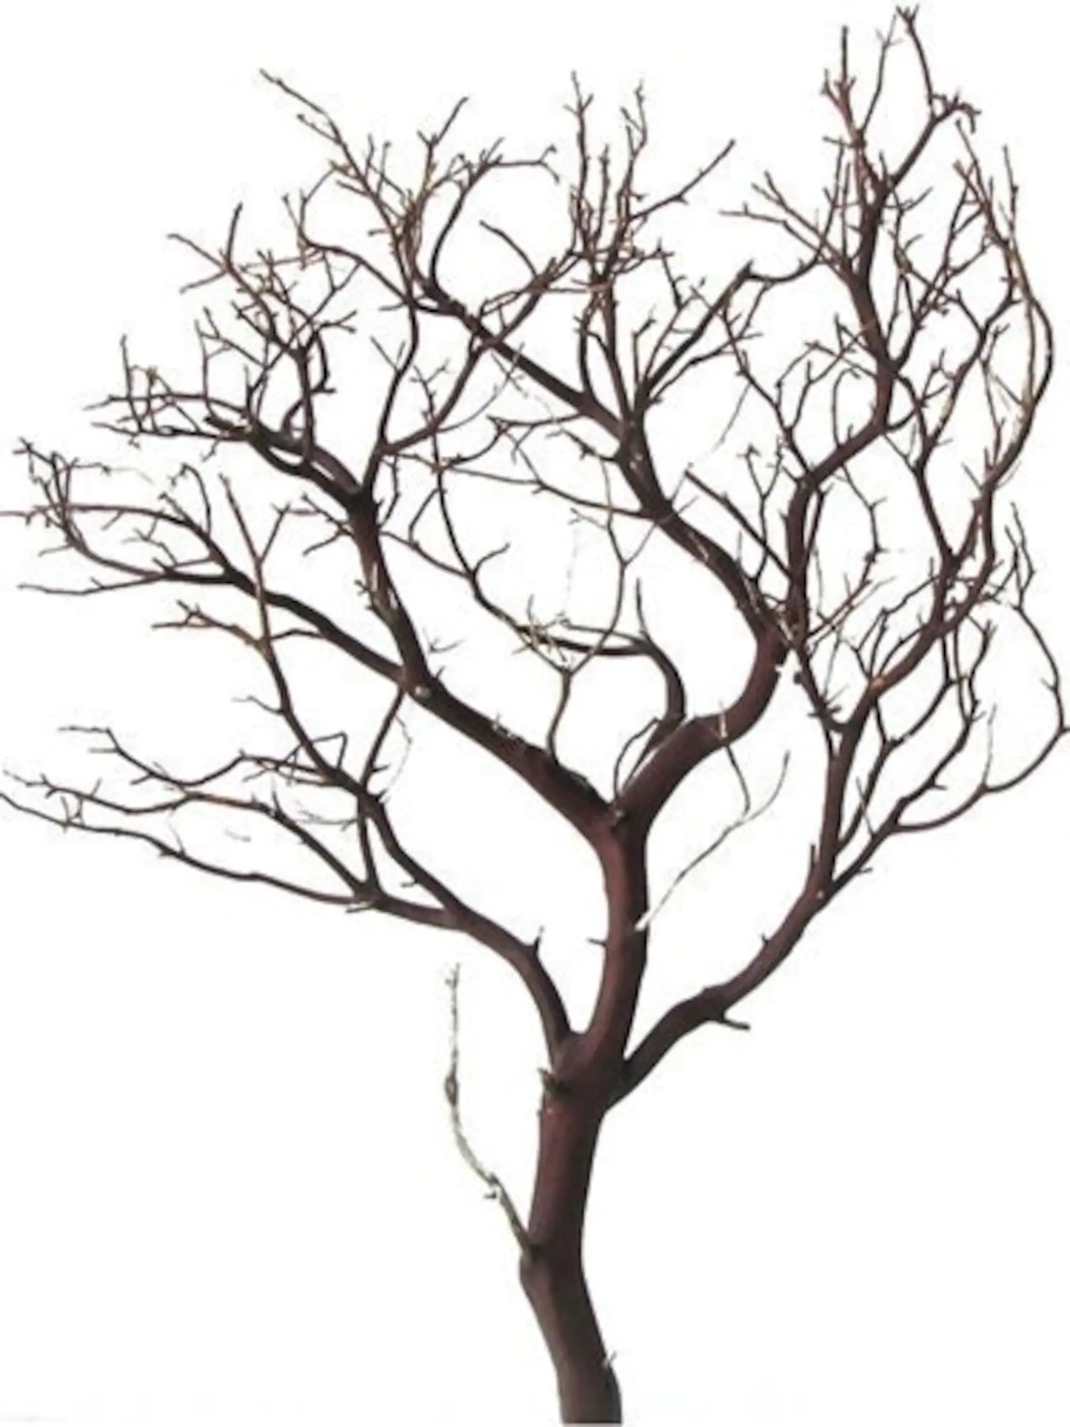
Git's "Killer Feature"

Slide 24
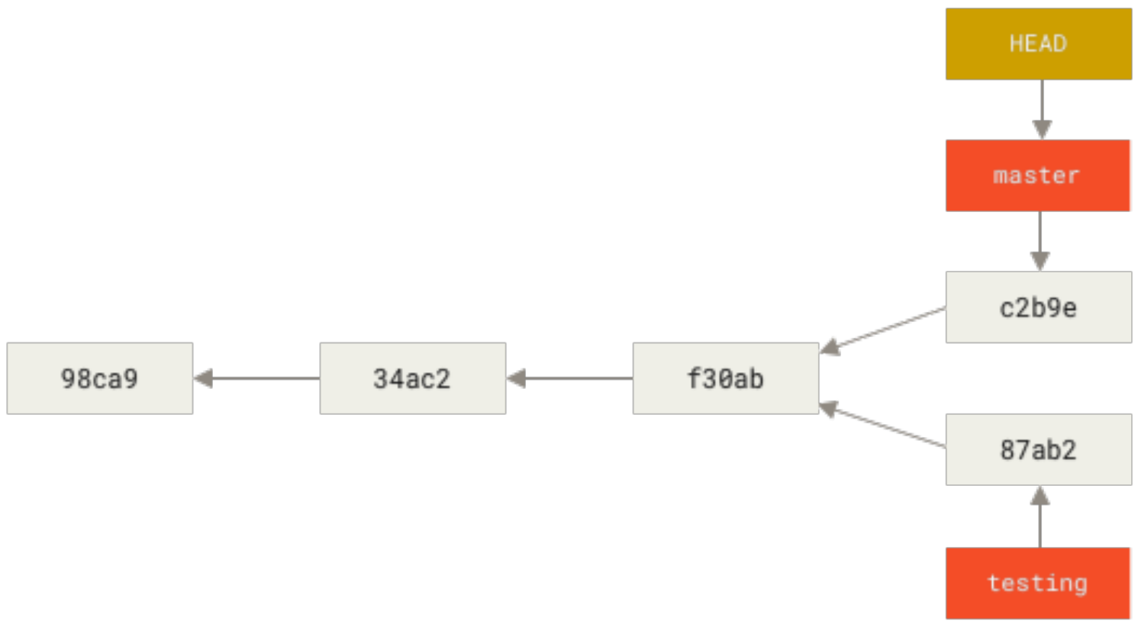
Git Branching
Git's Branching Model is known as its killer feature
If the changes to a file diverge in different directions, branches are created
The ability to create branches has made Git the most popular version control tool.
1. Chacon, Pro Git, 70.

Slide 25
Git Branching
print("Bygone")
When changes diverge
print("Bye, Bye")
print("Goodbye")
print("Hello, World")
print("Bye, World")
print("Bye, Felicia")

Slide 26
Git Branching
print("Bygone")
When changes diverge
All commits have a parent
print("Bye, Bye")
print("Goodbye")
print("Hello, World")
print("Bye, World")
print("Bye, Felicia")

Slide 27
Git Branching
Word Branch
print("Bygone")
When changes diverge
Bye Branch
Bye Branch
print("Bye, Bye")
print("Goodbye")
Main Branch
Main Branch
print("Hello, World")
print("Bye, World")
Felicia Branch
print("Bye, Felicia")

Slide 28

Git Branching
Development Branch
When changes diverge
The first branch of the repository is called the Main Branch or the Master Branch
Many repositories only have Main Branch
The Main Branch can be thought of as the tree trunk of the repository
The Git repository is also referred to as the working tree
Main Branch

Slide 29
What does a commit look like?
commit a0ef04228302e8c311f0dcb504b3802e93e4ea82
(HEAD -> development, origin/development)
Author: Ben Wilson <ben.wilson@dkomplex.com>
Date: Tue Feb 8 17:44:18 2022 -0800
Refactor API
Commit
Commit Hash: a unique ID for the commit
Branch of Commit: name of the branch the commit was made on
Author of Commit: name and email of who made the commit
Date of Commit
Commit Message

Slide 30
Pop Quiz
What percentage of professional developers use Git?
Answer: About 97% of professional developers use Git.

Slide 31
Pop Quiz
2. How do most professional developers interact with Git?
Answer: Most professional developers use Git on the command line.

Slide 32
Pop Quiz
3. Who was the original author of Git?
Answer: Linus Torvalds originally authored Git in 2005.

Slide 33
Pop Quiz
4. What is the difference between centralized and distributed version control?
Answer: With distributed version control each repository fully mirrors the central repository hosted by the server.

Slide 34
Pop Quiz
5. How does Git see data?
Answer: Git sees a series of snapshots of a filesystem.

Slide 35
Pop Quiz
6. What are the three stages of a commit?
Answer:
1. Modified
2. Staged
3. Committed

Slide 36
Pop Quiz
7. What is Git's killer feature?
Answer: The branching model is known as Git's killer feature.

Slide 37
3. Making Commits
Notes:
Setup:
Marketing material
Introduce dKomplex
Goal: create an attraction. Bring awareness about company.
-We are a net exporter of talent
-We have hired and trained CSUMB students
-We’re looking for a few good people. The best of the best.
-Move young talented people up. You get the opportunity to be in a big role.
-You get real responsibility and experience with us.
-I’m looking to hire throughout the year and keep our pipeline full of talented developers and analysts.
-Right now
-Which one of you is the next dkomplexer?
-
Remarks
-
Call Ben up to introduce
-

Slide 38
Hands On Demo
Git on the command line
What are some common Git commands?

Slide 39
Group Discussion
Two minutes
Write down all the git commands that you know

Slide 40
Group Discussion
Two minutes
What did you just learn about Git commands?

Slide 41


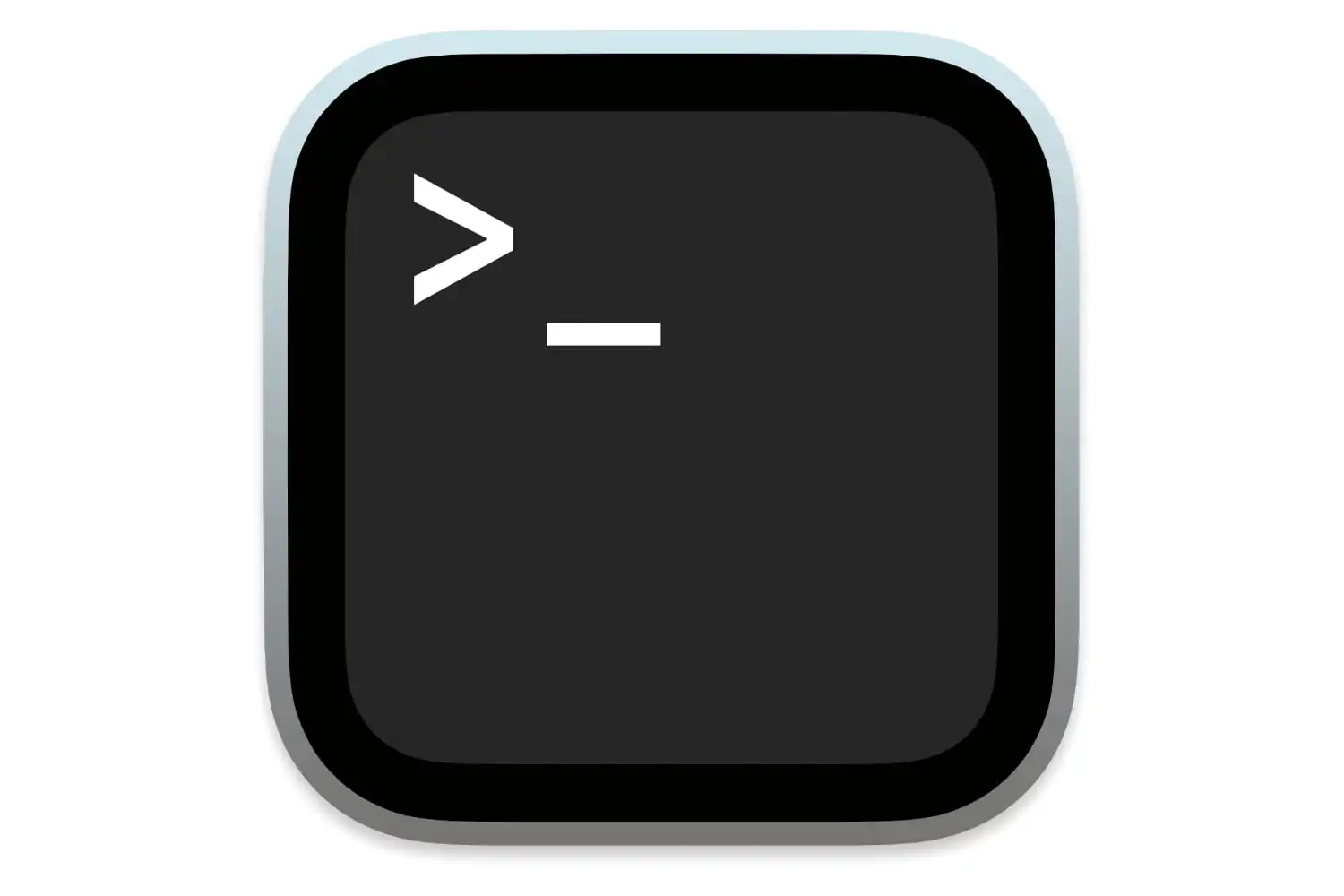


The Command Line
Notes:
Everyone should pay attention and watch me as I go through this. Trust me when I say this, if you try to follow along you may miss something and you will be lost. So don't touch the keyboard and watch as I show you how to do this correctly.

Slide 42
Basic Command Line
The dollar sign $ indicates a command
A directory is a folder on the command line
Short for "List"
List files in your directory
$ ls
$ cd
$ pwd
Short for "Change Directory"
Move to a different directory
Short for "Print Working Directory"
Determine what directory you're in

Slide 43
Git Commands
How do you know if Git is installed?
$ git --version

Slide 44
Git Commands
How do you clone a repository?
$ git clone

Slide 45
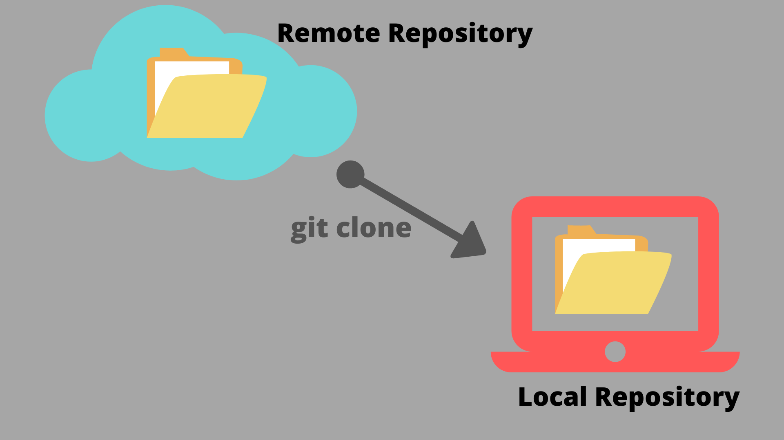
git clone
Copies a remote repository

Slide 46
Git Commands
How do you clone the Git Demo repository?
$ git clone https://github.com/ dkomplex-inc/gitdemo.git

Slide 47
Git Commands
How do you navigate to the repository on the command line?
$ ls
$ cd gitdemo

Slide 48
Git Commands
How do you know you're in the right repository?
Short for "Print Working Directory"
Determine what directory you're in
$ pwd

Slide 49
Git Commands
What files are in the repository?
Short for "List"
List files in your directory
$ ls

Slide 50
Get into the repository
1. Clone the repository
$ git clone https://github.com/dkomplex-inc/gitdemo.git
2. Change Directory
$ cd gitdemo
3. Confirm you are in the repository
$ pwd

Slide 51
Make a Commit
Five minutes
Get in your groups
Try to make a commit yourself
Ask your teammates for help

Slide 52
Group Discussion
Five minutes
What did you do to make a commit?
What was your reaction?
What did you learn?

Slide 53
What are the three stages of a commit?
1. Modified
2. Staged
3. Committed

Slide 54



1. Modified
How do you modify a file?
How do you open your editor?
$ notepad helloworld.py
$ code helloworld.py
$ vim helloworld.py
$ emacs helloworld.py

Slide 55
Git Commands
How do you know if files have been modified?
$ git status

Slide 56
Git Status
$ git status
On branch main
Changes not staged for commit:
(use "git add <file>..." to update what will be committed)
(use "git restore <file>..." to discard changes in working directory)
modified: helloworld.py
no changes added to commit (use "git add" and/or "git commit -a")
Three excellent questions
1. What branch are you on?
2. Have any files been modified?
3. Which files are staged?

Slide 57
2. Staged
Staged means that you have marked a modified file in its current version to go into your next commit snapshot.

Slide 58
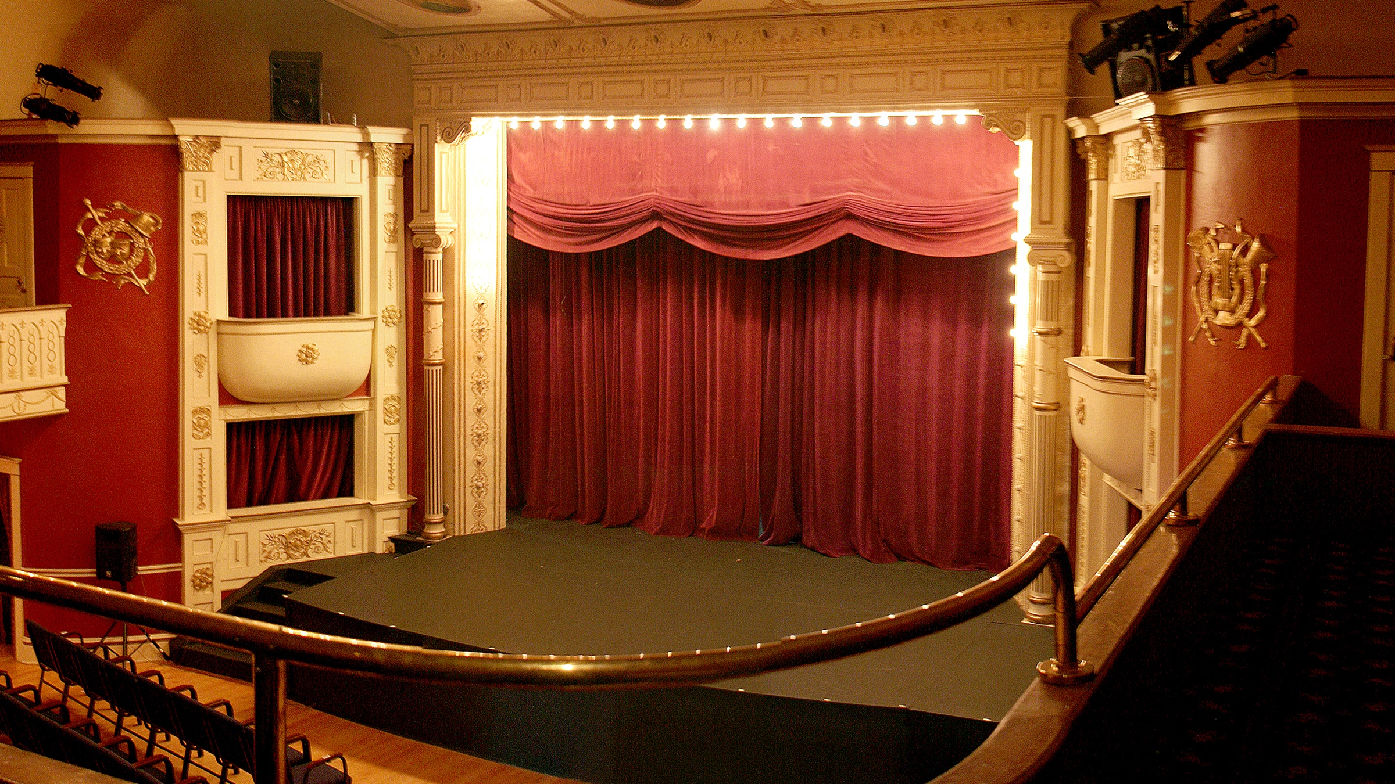
The Repository as a Stage
To make a commit of a file it must be added to the stage.
Files that are not added to the stage are not captured by git.
This allows you to be selective about what you are changing.

Slide 59
Git Commands
How do you add a file to the stage?
$ git add

Slide 60
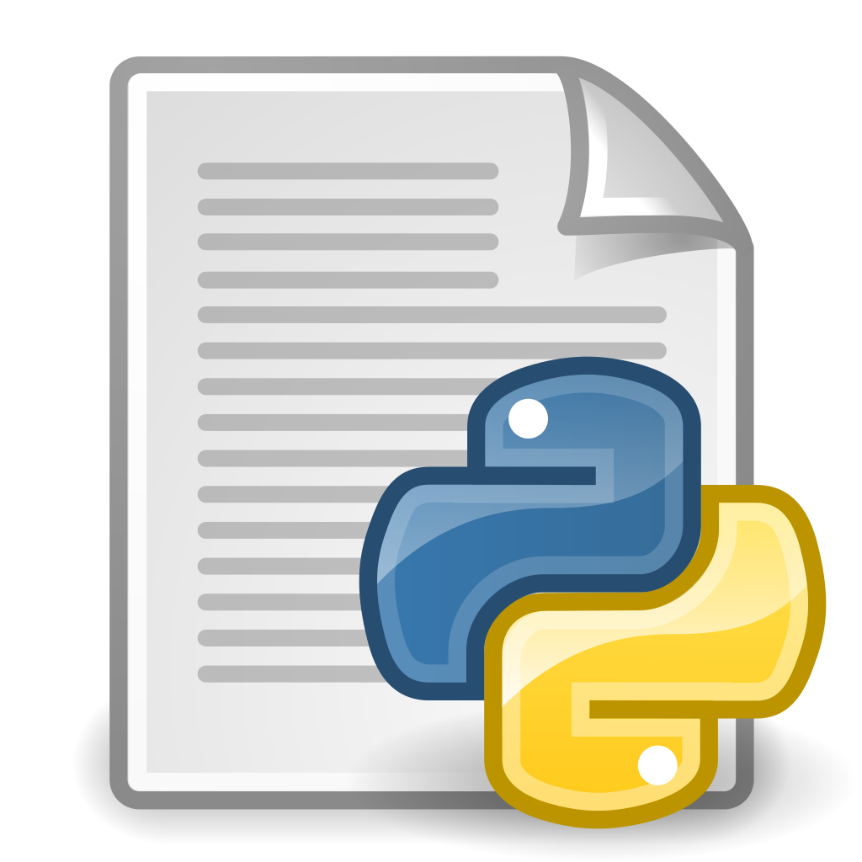
Git Add
Add files to the stage

Slide 61
Git Commands
How do you add helloworld.py
to the stage?
$ git add helloworld.py

Slide 62

$ git add helloworld.py

Slide 63
Git Commands
How do you know if files have been staged?
$ git status

Slide 64
Git Status
$ git status
On branch main
Changes to be committed:
(use "git restore --staged <file>..." to unstage)
modified: helloworld.py
Three excellent questions
1. What branch are you on?
2. Have any files been modified?
3. Which files are staged?

Slide 65
3. Committed
Committed means that the snapshot is stored in Git.

Slide 66
Git Commands
How do I commit my changes?
$ git commit

Slide 67
Git Commit
Commit
Only files on the stage are captured by Git
Take a snapshot

Slide 68
Git Commands
How do you write a commit message?
$ git commit –m "Commit Message"

Slide 69
Make a Commit
1. Modified
Edit the file
2. Staged
$ git add <file>
3. Committed
$ git commit –m "Commit message"

Slide 70
Git Commands
How do you see your commits?
$ git log
Press "q" to quit

Slide 71
Git Log
View commits
$ git log
commit 40582362ca3929736d04a2fa117b85675f3734df (HEAD -> main)
Author: Ben Wilson <21131bw@dkomplex.com>
Date: Tue Oct 18 10:53:10 2022 -0700
Change program to print I love Git!
commit 29c3eecc3589c908e00a92b7150af6686dae4958
Author: Ben Wilson <21131bw@dkomplex.com>
Date: Tue Oct 18 10:51:43 2022 -0700
Make a modification to hello world program
commit 0080c49cd867876d9ef42bc78626fee279c6cdc4 (origin/main, origin/HEAD)
Author: Ben Wilson <ben.wilson@dkomplex.com>
Date: Wed Oct 12 22:30:47 2022 -0700
Add helloworld.py to repository

Slide 72
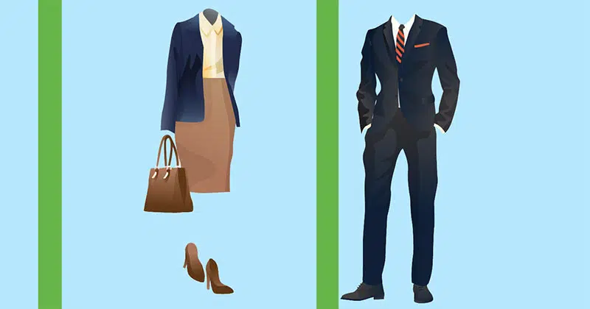
What makes Commits look professional?

Slide 73
What makes Commits look professional?
Spell your name and email correctly

Slide 74
Git Commands
How do you check your name and email stored in Git?
$ git config --list
Press "q" to quit

Slide 75

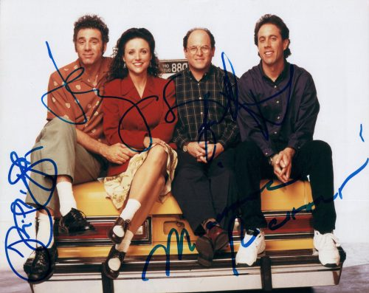
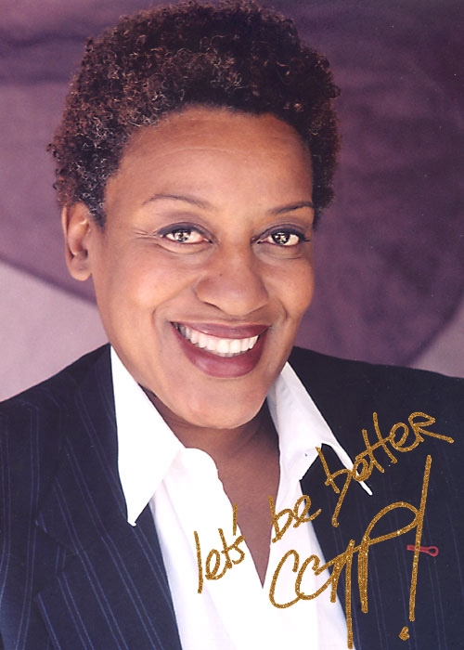
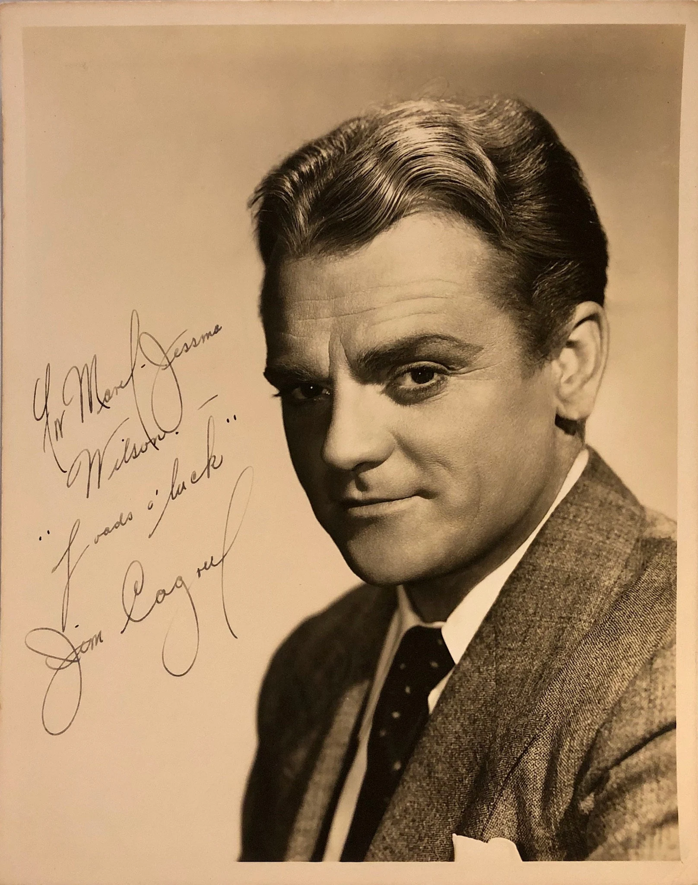

git config
commit a0ef04228302e8c311f0dcb504b3802e93e4ea82
(HEAD -> development, origin/development)
Author: bjamin <benpersonalemail@hotmail.com>
Date: Tue Feb 8 17:44:18 2022 -0800
Refactor API
Your commit autograph
commit a0ef04228302e8c311f0dcb504b3802e93e4ea82
(HEAD -> development, origin/development)
Author: Ben Wilson <ben.wilson@dkomplex.com>
Date: Tue Feb 8 17:44:18 2022 -0800
Refactor API

Slide 76
Git Commands
How do you configure your name in Git?
$ git config user.name "Justin Loza"

Slide 77
Git Commands
How do you configure your email in Git?
$git config user.email justin.loza@dkomplex.com

Slide 78
$ git config --list
$ git config user.name "Your Name"
$ git config user.email your.name@email.com

Slide 79
What makes Commits look professional?
Write a good commit message

Slide 80
Good Commit Messages
Describe what has changed
Keep it under 50 characters
Capitalize the first word
Use the imperative style
Ask yourself
"If these changes were applied, they would: "

Slide 81
Commit Message
Bad Commit Messages
$ git commit –m "fixed bug"
$ git commit –m "Changed style"
$ git commit –m "oops"
$ git commit –m "Did I fix it?"
$ git commit –m "This message is way longer than fifty characters and should be shorter"

Slide 82
Commit Message
Good Commit Messages
"If these changes were applied, they would: "
$ git commit –m "Edit file.txt"
$ git commit –m "Add README.md"
$ git commit –m "Update REST API"
$ git commit –m "Refactor main function"

Slide 83
What makes Commits look professional?
Using Branching

Slide 84
Git Commands
How do you know what branch you're on?
$ git branch

Slide 85
git branch
Where are you?
You're on the Main Branch
Main Branch

Slide 86
Git Commands
How do you view all of the branches?
$ git branch -a

Slide 87
git branch -a
Development Branch
Resources Branch
What branches are there?
These are the branches in the repository
Main Branch

Slide 88
Git Commands
How do you create a new branch?
$ git branch <branch name>

Slide 89
$ git branch mybranch
mybranch
Development Branch
Main Branch
Create a new branch called "mybranch"

Slide 90
Git Commands
How do you move to a different branch?
$ git checkout <branch name>

Slide 91
Git Commands
How do you move to the development branch?
$ git checkout development

Slide 92
git checkout
Development Branch
Move to a different branch
I want to go check out the development branch
Main Branch

Slide 93
Git Commands
How do you know you have moved to the development branch?
$ git branch

Slide 94
git branch
Development Branch
Where are you?
You're on the Development Branch

Slide 95
$ git branch........................Where are you?
$ git branch -a.................What branches are there?
$ git branch <branch>....Create a new branch
$ git checkout...................Move to a different branch
$ git checkout –b............Create and checkout a branch

Slide 96
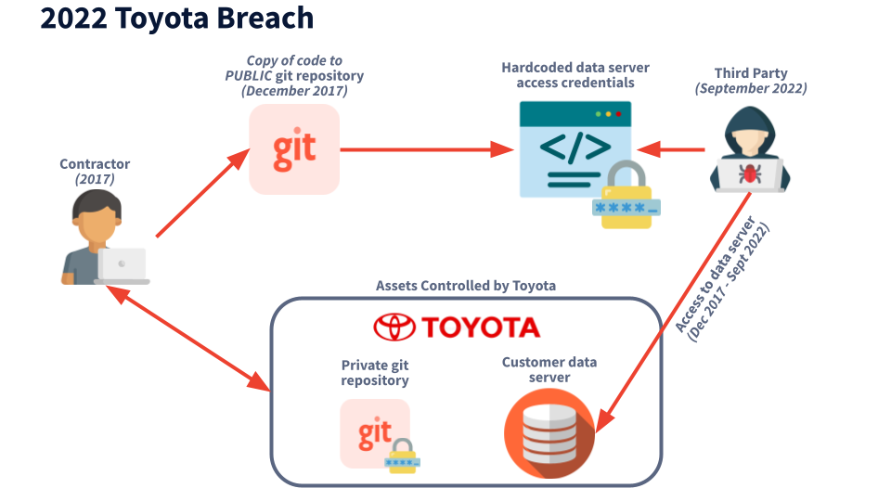
Don't Commit Secrets!
On October 7, 2022 Toyota revealed they had accidentally exposed a credential allowing access to customer data in a public GitHub repo for nearly 5 years.
This leaked access to personal information of 300K customers.
This incident adds Toyota to the list of companies that have had similar exposures; a list that includes Samsung, Nvidia, and Twitch, just to name a few.

Slide 97
Git Commands
How do you push your changes?
$ git push

Slide 98
Git Commands
How do you push your changes on a specific branch?
$ git push origin main
$ git push origin mybranch

Slide 99
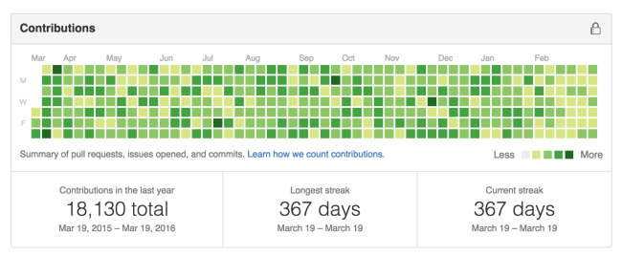
Looking Professional
$ git log
commit a8cd81bc833195c016ffd9ceab3da7e0349bda0c (HEAD -> ben)
Author: Ben Wilson <ben.wilson@dkomplex.com>
Date: Wed Oct 12 23:05:16 2022 -0700
Update helloworld.py to print Bye, Felicia!
commit 7fc3e360da6206d41a5b7bf3ca69fc7f0ce156a7 (origin/development, development)
Author: Justin Loza <justin.loza@dkomplex.com>
Date: Wed Oct 12 22:46:27 2022 -0700
Save super secret meatball recipe in Git
commit d0caa454f6d8cab839429416354c936d5ac721fb
Author: Ben Wilson <ben.wilson@dkomplex.com>
Date: Wed Oct 12 22:36:51 2022 -0700
Add database credentials to repository
commit 0080c49cd867876d9ef42bc78626fee279c6cdc4 (origin/main, origin/HEAD, main)
Author: Ben Wilson <ben.wilson@dkomplex.com>
Date: Wed Oct 12 22:30:47 2022 -0700
Add helloworld.py to repository
Configure your name and email correctly
Use a consistent commit message style
Use Branching
Don't commit secrets!
Make lots of commits!

Slide 100
Open Discussion
What is your reaction to this information?
What did you learn?

Slide 101
Resources
$ git checkout resources
https://git-scm.com
Pro Git by Scott Chacon
and Ben Straub
This PowerPoint
Helpful links in links.txt
Contact us at dKomplex IT
Notes:
Setup:
Marketing material
Introduce dKomplex
Goal: create an attraction. Bring awareness about company.
-We are a net exporter of talent
-We have hired and trained CSUMB students
-We’re looking for a few good people. The best of the best.
-Move young talented people up. You get the opportunity to be in a big role.
-You get real responsibility and experience with us.
-I’m looking to hire throughout the year and keep our pipeline full of talented developers and analysts.
-Right now
-Which one of you is the next dkomplexer?
-
Remarks
-
Call Ben up to introduce
-

